Slide 1

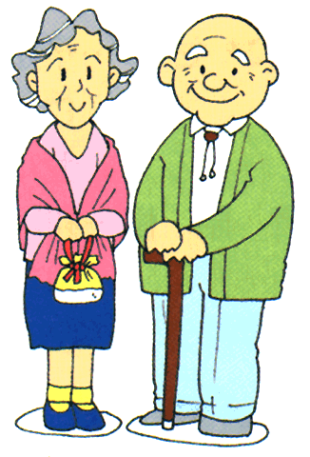
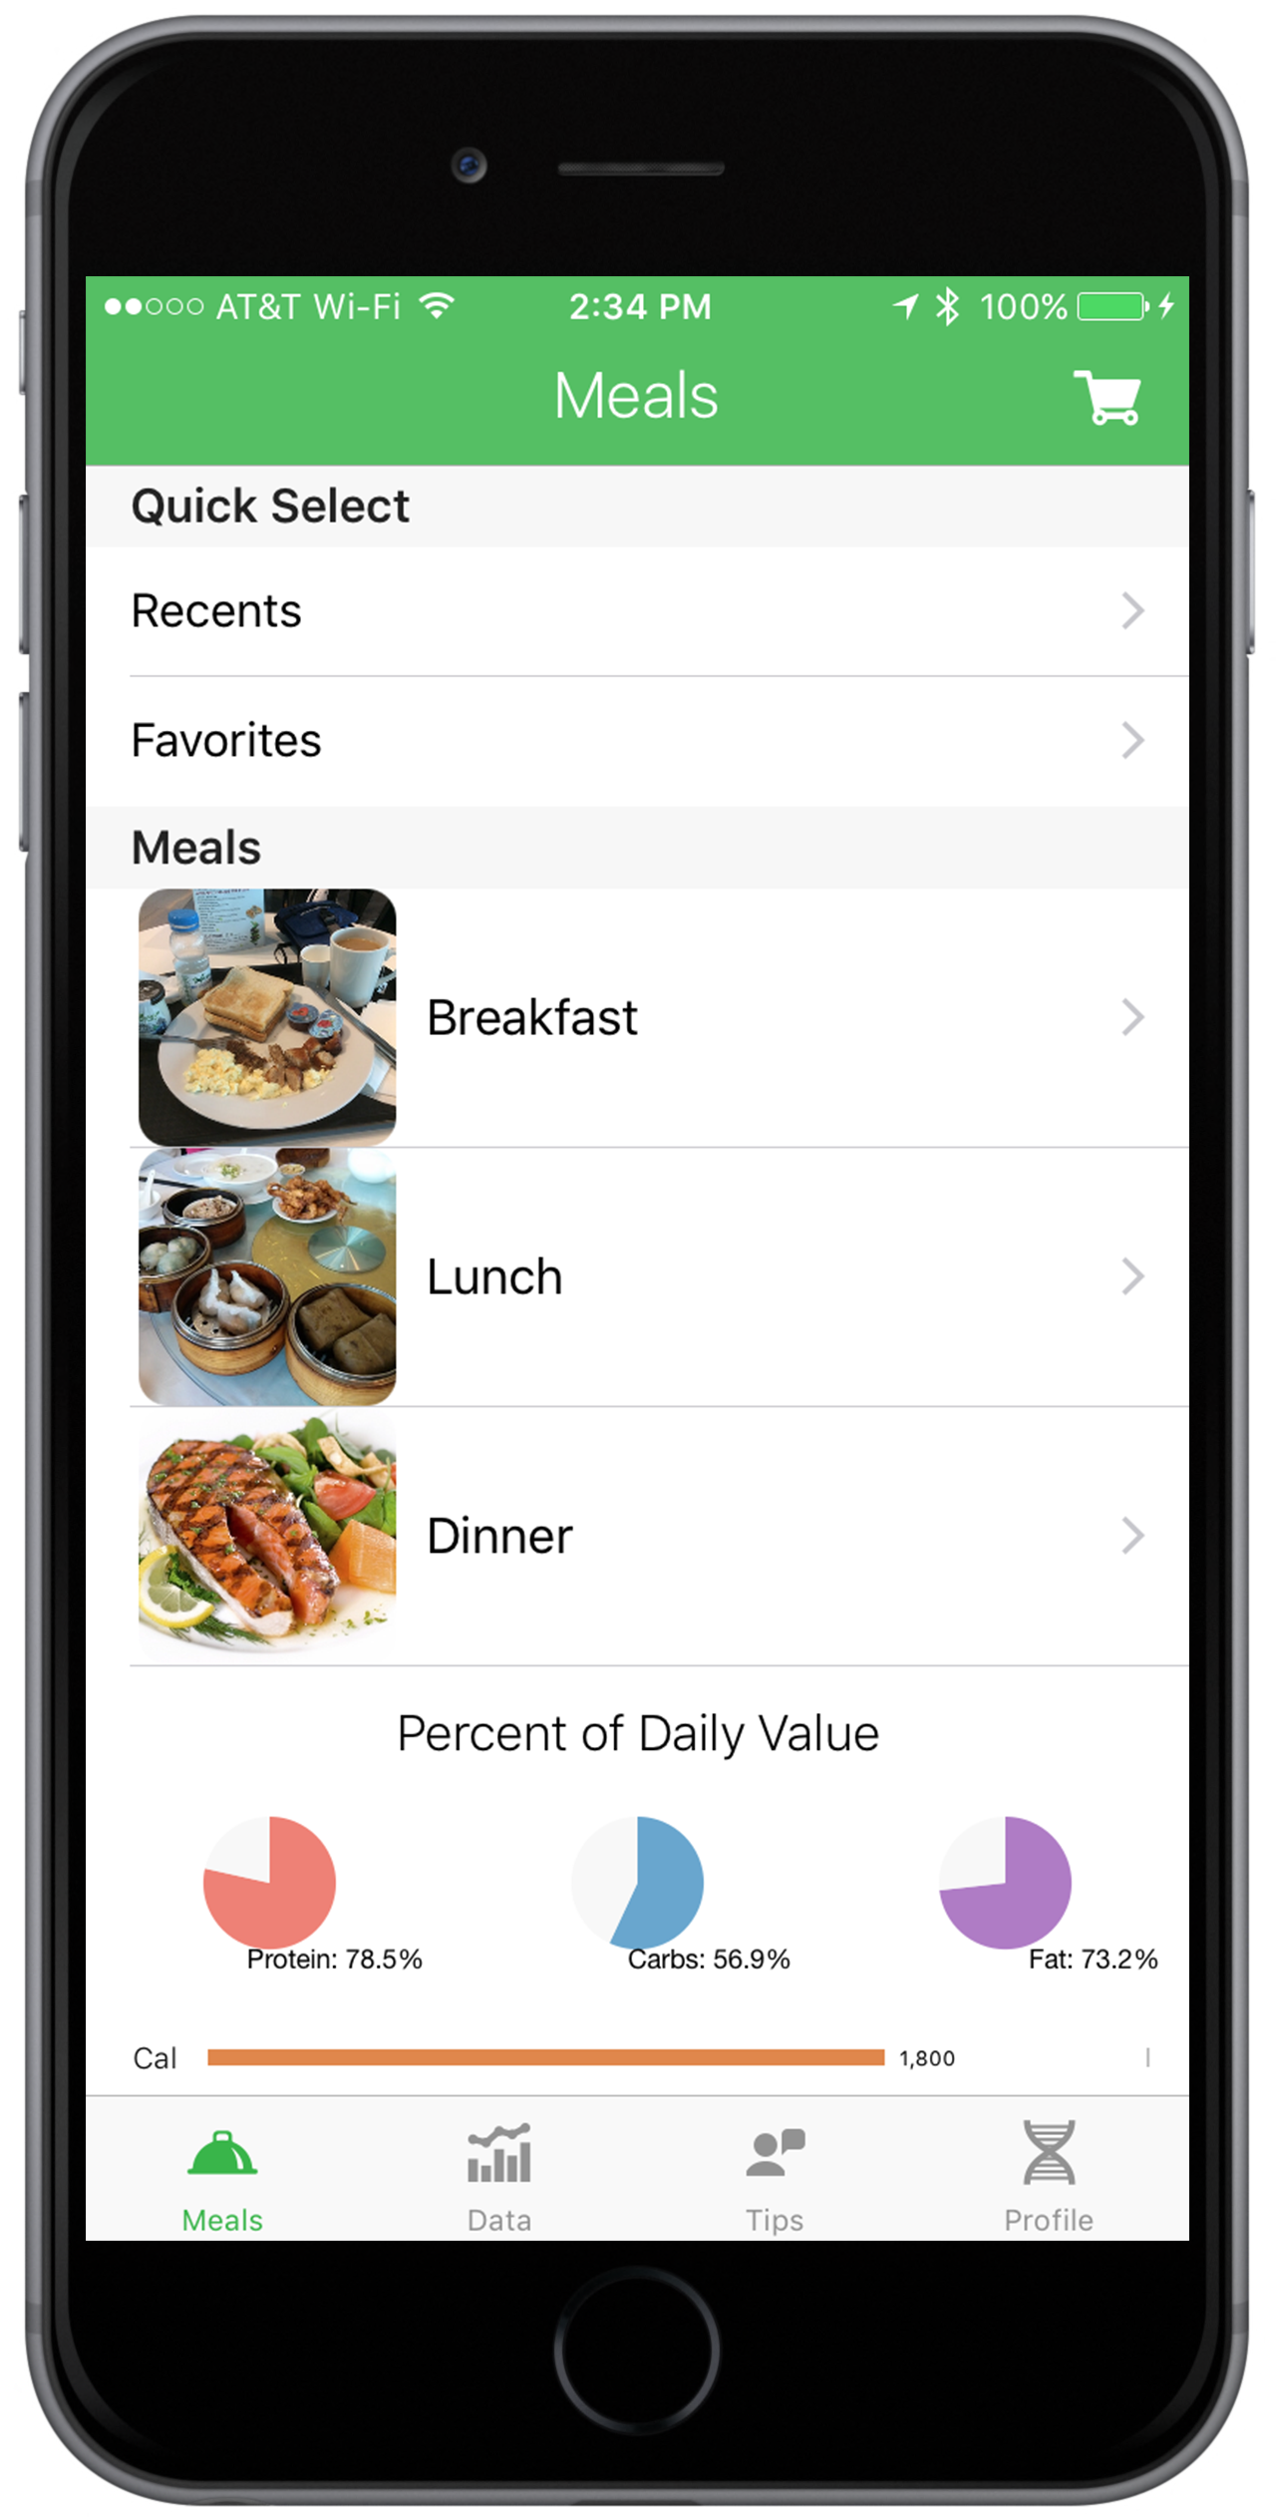
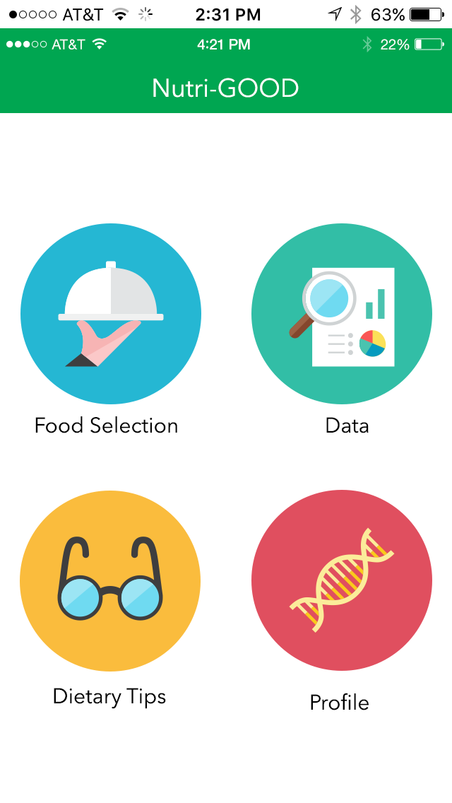
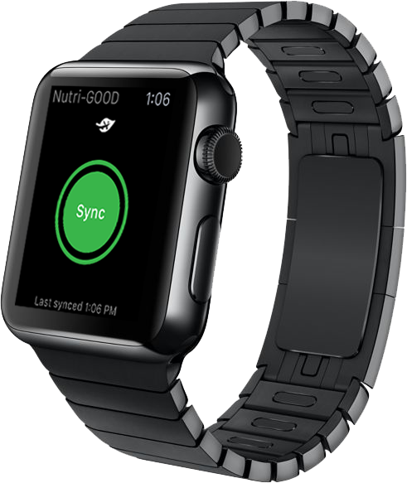
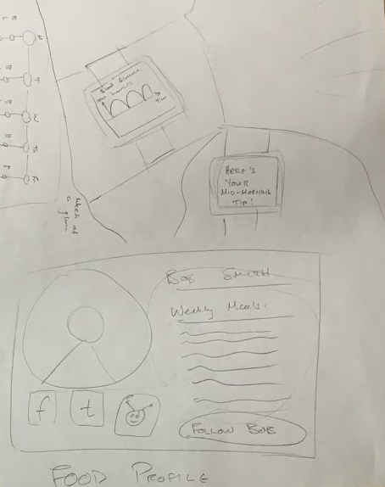
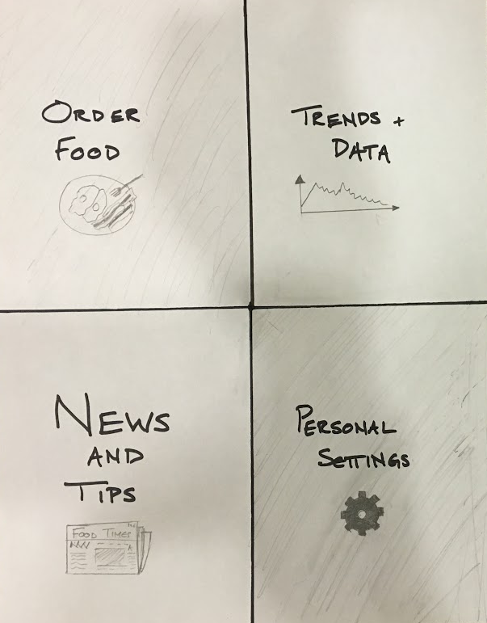
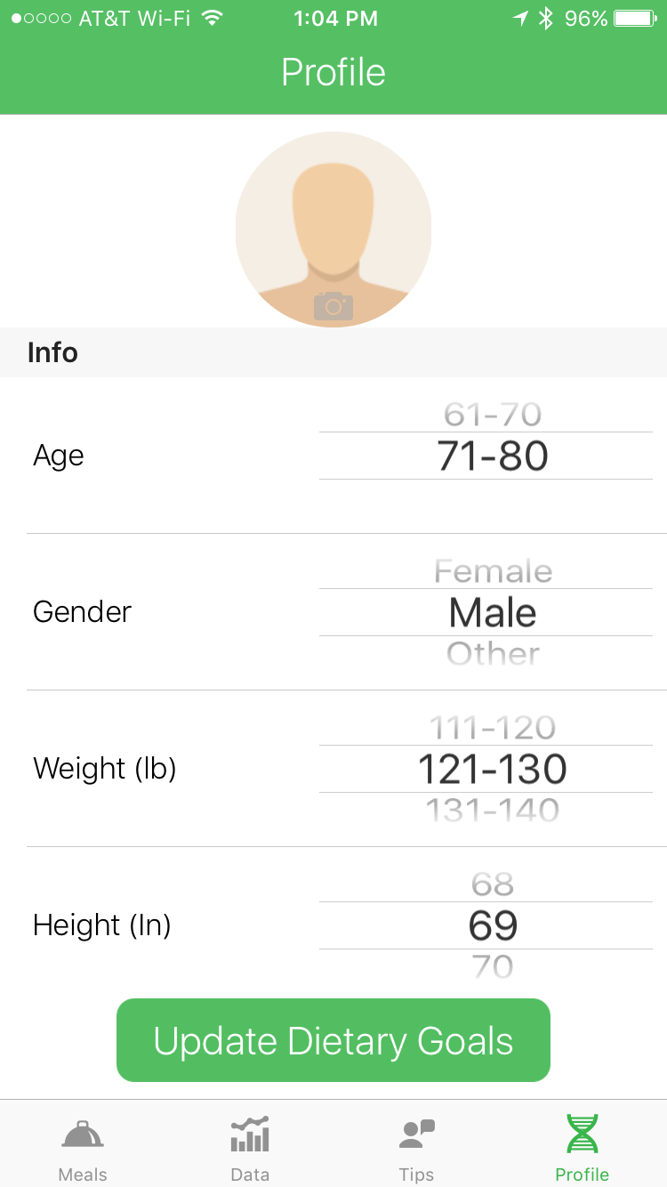
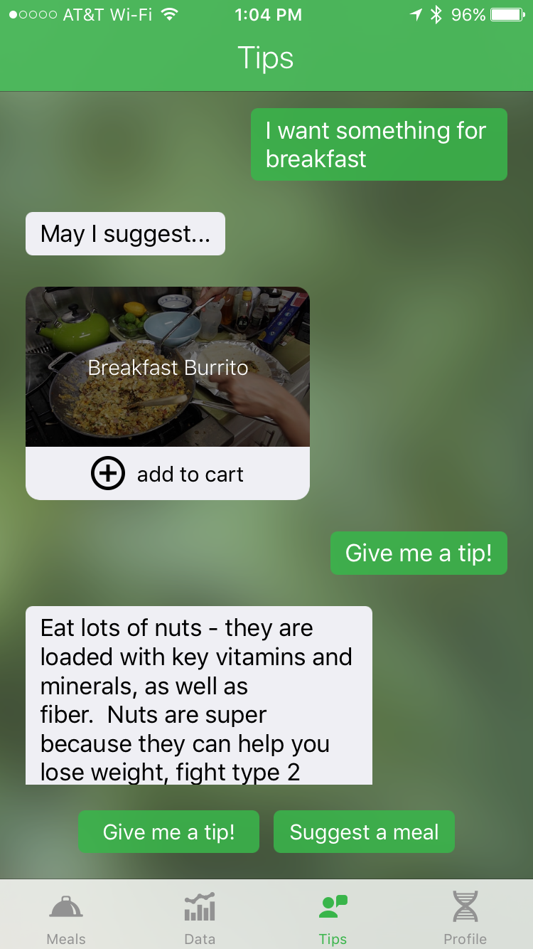
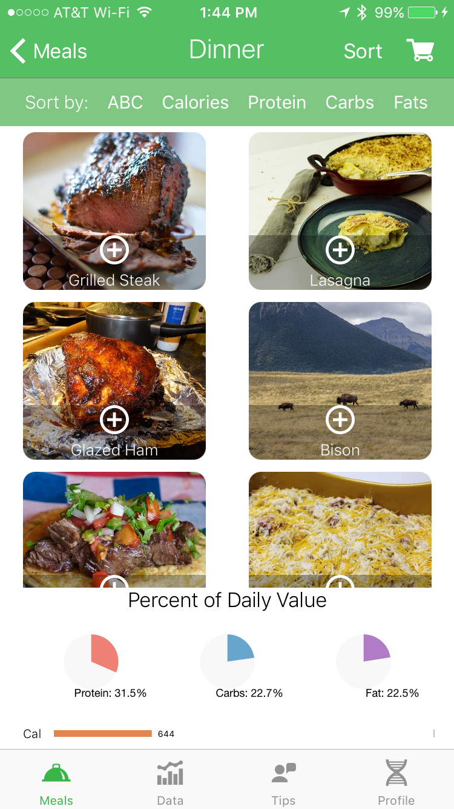
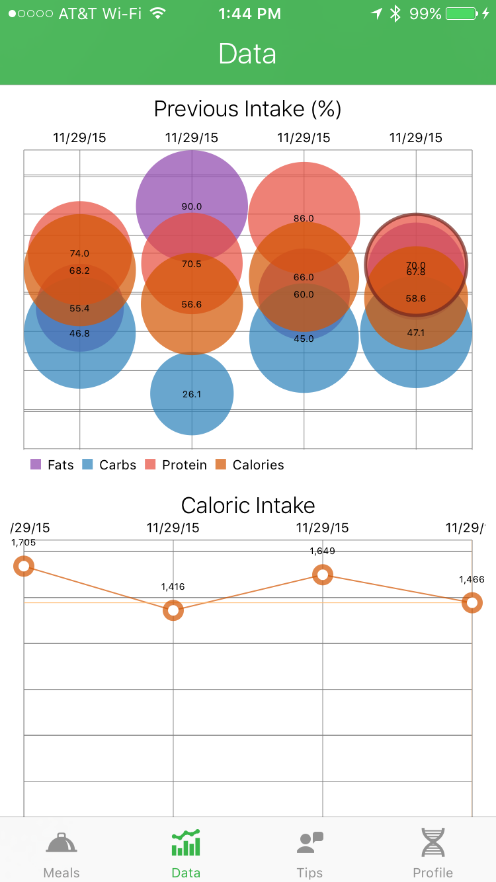
Nutri-GOOD
Independent nutrition, delivered.
Keeping track of my nutrition is really difficult
Solution
Simplify nutrition management by delivering ingredients for pre-selected meals
Maintain independence in the cooking process
Track nutritional information using in-app analytics
Companion wearable application allows the user to sync biometric information
Educate users with an engaging and enjoyable tip-based AI
I want to cook on my own and learn from my nutrition
Design Iteration
High-fi (Swift)
Medium-fi (Marvel)
Low-fi (sketches)
Key Features
Enter personal info and set dietary goals
Get tips and suggestions from our friendly AI
Choose from our specially-prepared meal selection
Track your nutrition trends and data
Andrew Barakat • Manny Cortes • Andrew Fang • Jorge Garcia
http://web.stanford.edu/class/cs147/projects/health/nutri-good/
CS 147
Autumn 2015

